Slide 1

UNIT – 1 18CSC305J / ARTIFICIAL INTELLIGENCE

Slide 2
AI Techniques
AI Applications is spread across the Domains and across the complexities of the problem that includes the following:
Various Day-to-Day Practical Problems
Different Identification and Authentication Problems
Various Classification problems resulting in decision making
Interdependent and cross-domain problems

Slide 3
Challenges of AI Techniques
AI Techniques need to be build from problem-solving perspectives. the points needed for AI technique are:
Need for analysis and large amount of data
Analysis should be followed by the mapping of data with build in knowledge
Dealing with constantly changing scenarios and situations
Identification of relevant data and irrelevant data are challenges of AI Techniques.

Slide 4
The Top 4 AI Techniques are
Machine Learning
NLP(Natural Language Problem)
Automation and Robotics
Machine Vision

Slide 5
Characteristics of AI Techniques
Intelligence requires Knowledge.
Knowledge possesses less desirable properties such as:
Voluminous
Hard to characterize accurately
Constantly changing
AI technique is a method that exploits knowledge that should be represented in such a way that:
Knowledge captures generalization
It can be understood by people who must provide it.
It can be easily modified to correct errors.
It can be used in variety of situations.

Slide 6
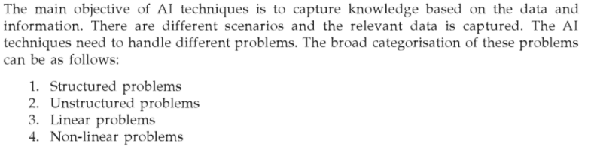

Slide 7
Problem Solving with AI
Define the problem.
Analyze the problem.
Isolate and represent the knowledge that is necessary for solution.
Select the best problem solving technique.

Slide 8
Well-Structured Problems
Well-Structured Problems-Commonly faced problems during day to day life.
Well-structured problems are those in which the initial state, goal state, and constraints are clearly defined.
eg:- Solving quadratic equation to find the value of X

Slide 9
Ill-structured problems
Ill-structured problems are ones students face routinely in everyday life. They include important social, political, economic, and scientific problems
Ill-Structured Problems-Problems which do not yield a particular answer
.(eg:- Predicting how to dispose wet waste safely)

Slide 10
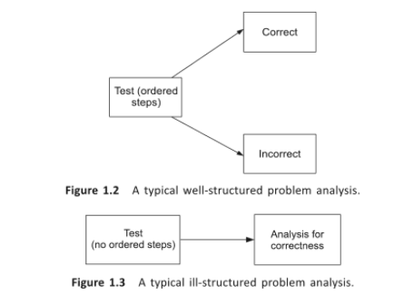

Slide 11
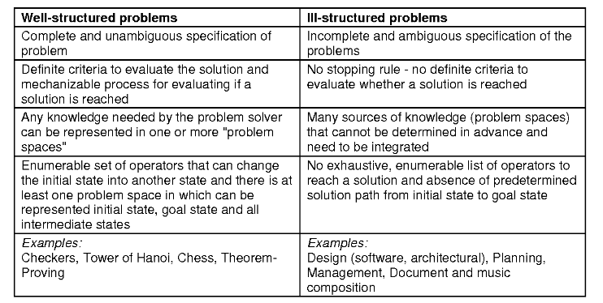
Difference between Well-Structured and III-Structured Problems

Slide 12
Linear Problem :
It is the problem which can be solved or where the decision can be obtained by linear solution.
Non-Linear Problem:
It is the problem which can be solved or seperated by linear equation.
The relationship between input and output is not linear.

Slide 13
AI Models
To understand the different types of AI learning models, we can use two of the main elements of human learning processes: knowledge and feedback.
From the knowledge perspective, learning models can be classified based on the representation of input and output data points.
In terms of the feedback, AI learning models can be classified based on the interactions with the outside environment, users and other external factors.

Slide 14
Knowledge-Based Classification
Factoring its representation of knowledge, AI learning models can be classified in two main types: inductive and deductive.
Inductive Learning:
This type of AI learning model is based on inferring a general rule from datasets of input-output pairs.
Algorithms such as knowledge based inductive learning(KBIL) are a great example of this type of AI learning technique.
KBIL focused on finding inductive hypotheses on a dataset with the help of background information.

Slide 15
Deductive Learning:
This type of AI learning technique starts with the series of rules and infers new rules that are more efficient in the context of a specific AI algorithm.
Explanation-Based Learning(EBL) and Relevance-0Based Learning(RBL) are examples examples o f deductive techniques.
EBL extracts general rules from examples by “generalizing” the explanation.
RBL focuses on identifying attributes and deductive generalizations from simple example.

Slide 16
Feedback-Based Classification
Based on the feedback characteristics, AI learning models can be classified as supervised, unsupervised, semi-supervised or reinforced.
Unsupervised Learning: Unsupervised models focus on learning a pattern in the input data without any external feedback. Clustering is a classic example of unsupervised learning models.
Supervised Learning: Supervised learning models use external feedback to learning functions that map inputs to output observations. In those models the external environment acts as a “teacher” of the AI algorithms.

Slide 17
Semi-supervised Learning: Semi-Supervised learning uses a set of curated, labeled data and tries to infer new labels/attributes on new data data sets. Semi-Supervised learning models are a solid middle ground between supervised and unsupervised models.
Reinforcement Learning: Reinforcement learning models use opposite dynamics such as rewards and punishment to “reinforce” different types of knowledge. This type of learning technique is becoming really popular in modern AI solutions.

Slide 18
What is data acquisition in artificial intelligence?
Data acquisition is the process of sampling signals that measure real world physical conditions and converting the resulting samples into digital numeric values that can be manipulated by a computer.
Signal conditioning circuitry, to convert sensor signals into a form that can be converted to digital values.

Slide 19
Data acquisition and learning aspects in AI
Knowledge Discovery
Computational Learning Theory(COLT)
Neural and Evolutionary computation
Intelligent Agent and Multi Agent System
Multi prespective Integrated Intelligence

Slide 20
Knowledge Discovery
It is about finding understandable knowledge.
Machine learning is a field concerned with the study of algorithms that will improve its performance with experience.
machine learning is more focused on improving performance of an agent.
Here the mining plays an implicit part.

Slide 21
Computational Learning Theory(COLT)
In COLT, formal mathematical problems are defined.
These models helps in analyzing the efficiency and complexity in terms of computation, prediction and feasibility of the algorithm.
computational learning finds its importance in the field of machine learning,pattern recognition and many more.
the goal is to inductively learn the target function.
there are two frameworks for analysing pattern probably approximate correct and mistake bound.

Slide 22
Neural and Evolutionary computation
The new technique is enabled to speed up the mining of data.
computational technique that are based on biological properties fall under the category of evolutionary computing.
In the case of neural computing, the neural behaviour of human being is simulated to enable machine to learn.
An ANN is formed for specific application like pattern recognition or classification.

Slide 23
Intelligent Agent and Multi Agent System
It is the core part of intelligent systems, which allows timely decision making in complex scenarios.
Intelligent agent is the one which is flexible in terms of its action to get the desired outcome.
It is goal directed and reacts with the environment and acts accordingly.
The percept of individual agent i always limited.
For complex tasks and decision making more agents are required to solve the problem that is called MAS.

Slide 24
Multi perspective Integrated Intelligence
Utilising and exploiting the knowledge from different perspective to build up an intelligent system giving accurate results builds the multi- perspective intelligence.
These approaches work in association with respect to the application they would be suited for. the good understanding of requirements and domain will result in an accurate predictions and decision making for solving a problem.

Slide 25
Problem Solving
It is an area to deal with finding answers for some unknown situations.
It involves understanding, representation,formulation and solving.
Simple problem : deterministic procedure.
Complex / Real world problem - search method
Problem solving - planning and decision making.

Slide 26
Problem Solving Process
Problem desired objective is not obvious/computational task.
problem solving - generating solutions for a given situation.
AI problem is formulated and solved by searching for a solution in space of possible solutions.
It may include sophisticated information,storage retrival,information extraction,decision making and so on.

Slide 27
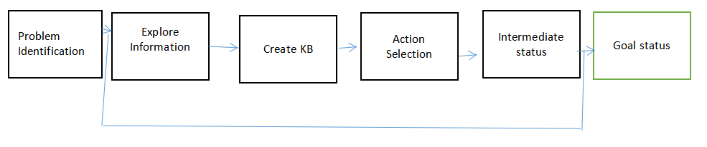
Problem Solving Process

Slide 28
Problem can be defined with following condition:
1. Every problem is defined in a context. n this context it has certain assumptions under initial condition.
2.Every problem has a well defined objective.
3.Solution to every problem consist of a set of activities.each activity have a state of process.
4.previous knowledge and domain knowledge both are used as the resource during different state in the solution process.

Slide 29
General problem solving techniques
Problem Definition
Problem Analysis and representation
Planning
Execution
Evaluating Solution
Consolidating Gains

Slide 30
Formulating Problems
First Step - Identification of problem in Problem solving process.
A problem statement can have description of data,method,procedure and algorithms that are used to solve it.
The next step is Analysis and Representation of the task knowledge.
this is done using state space diagram.an operator is applied to a state to move to next state. this approach is aclled State-Space method.

Slide 31
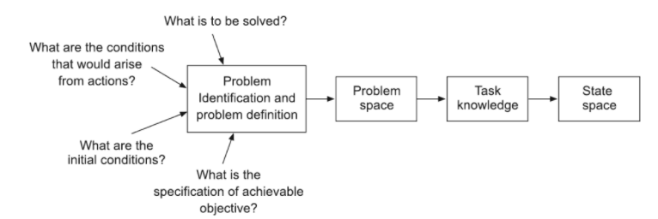
Problem Formulating steps

Slide 32
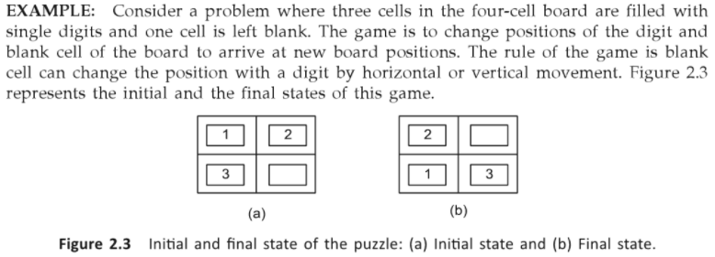

Slide 33
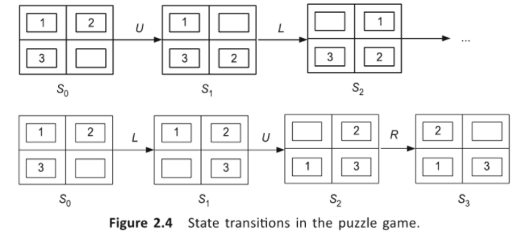
Solution

Slide 34
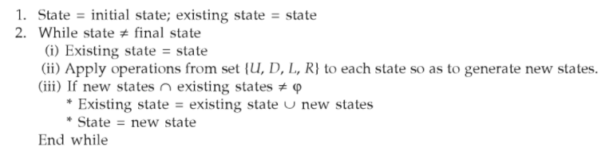
Algorithm

Slide 35
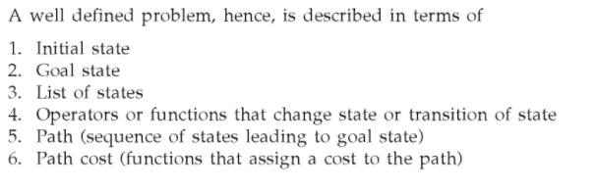

Slide 36
Problem Types and Characteristics
Deterministic and observable - single state problem
Non-Observable - multi state problem-no info about the state
Non-deterministic or partially observable - new info is added and then operator acts on the state soluion space. Solution space is the tree structure of the states.
Unknown state space - these are typically exploration problems. States and impact of the actions are not known.
Eg-searching address without map.

Slide 37
Problem Space and Search
Problem is represented as the state space.
Search plays the major role such as, search is a general algorithm that helps in finding the path in the state space.
the search algorithm, makes use of control strategy like that of forward or backward search.
There are two types of strategies
informed search and
uninformed seach.

Slide 38
Informed Search
In this approach, a heuristic that is specific to the problem is used to control the flow of solution path.
Heuristic is a skill based technique used to solve the problem.
It is based on common sense, rule of thumb,educated guesses or intuitive judgement.
When speedy process is required, informed search is preferred.

Slide 39
Uninformed Search
It does not consider any specific nature of the problem.
It is very simple and can be generalized to any problem.
This strategy generates all possible states in the state space and checks for the goal state.
But, this approach is time consuming, as the state space is large.
This method is used to benchmark results of the algorithm.
The search methods are evaluated on the basis of completeness, optimality, time and space complexities.

Slide 40
Issues in designing search problem
State representation and identifying relationships among states
Proper selection of forward and backward movement to determine optimal path to goal state
Rule selection

Slide 41
Intelligent Agent
Intelligence is a cummulative manifestation of different activities resulted from learning, sensing, understanding and knowledge augmentation.
It has an association with environment.
An agent is an entity that can preceive the information and act on that information to acheive the desired outcome.
Intelligent agent is an agent that is capable of making decisions and act most logically in the scenario.

Slide 42
An agent is anything that can perceive its environment through sensors and acts upon that environment through effectors.
A human agent has sensory organs such as eyes, ears, nose, tongue and skin parallel to the sensors, and other organs such as hands, legs, mouth, for effectors.
A robotic agent replaces cameras and infrared range finders for the sensors, and various motors and actuators for effectors.
A software agent has encoded bit strings as its programs and actions.

Slide 43
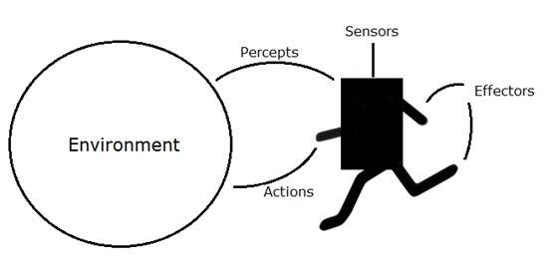
Agent and Environment

Slide 44
Agent Terminology
Performance Measure of Agent
It is the criteria, which determines how successful an agent is.
Behaviour of Agent
It is the action that agent performs after any given sequence of precepts.
Percept
It is agent’s perceptual inputs at a given instance.
Percept Sequence
It is the history of all that an agent has perceived till date.
Agent Function
It is a map from the precept sequence to an action

Slide 45
What is Ideal Rational Agent?
An ideal rational agent is the one, which is capable of doing expected actions to maximize its performance measure, on the basis of :
Its percept sequence
Its built-in knowledge base
Rationality of an agent depends on the following:
The performance measures, which determine the degree of success.
Agent’s Percept Sequence till now.
The agent’s prior knowledge about the environment.
The actions that the agent can carry out.

Slide 46
The Structure of Intelligent Agents
Agent’s structure can be viewed as −
Agent = Architecture + Agent Program
Architecture = the machinery that an agent executes on.
Agent Program = an implementation of an agent function.
Condition-Action Rule − It is a rule that maps a state (condition) to an action.
Simple Reflex Agents
They choose actions only based on the current percept.
They are rational only if a correct decision is made only on the basis of current precept.
Their environment is completely observable.

Slide 47
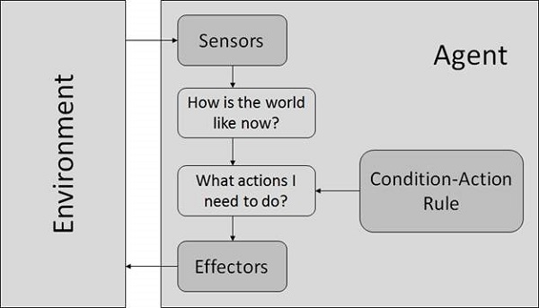
Simple Reflex Agents

Slide 48
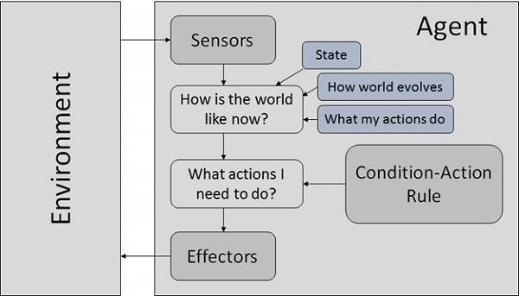
Model Based Reflex Agents

Slide 49
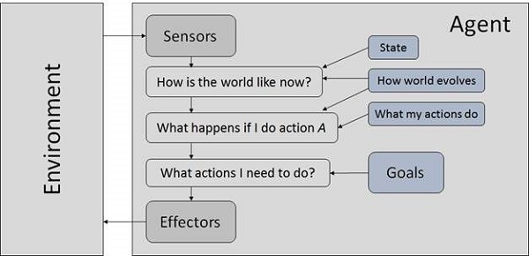
Goal Based Agents

Slide 50
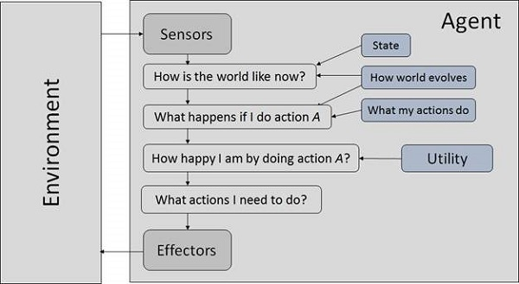
Utility Based Agents

Slide 51
Flexibilty and Intelligent Agents
Intelligence demands flexibility. Hence, agents need to be flexible.
The flexibility equips the agent to negotiate with dynamic scenarios.
To exhibit the required intelligence, we expect certain properties associated with flexibility from an intelligent agent.
Responsive
Pro-active
Social

Slide 52
Other properties an intelligent agent should have are :
Mobility
Veracity
Benevolence
Rationality
Learning

Slide 53
Task Environment and its properties
The Task Environment is the environment in which the task takes place.
Clearly defining task environment along with the desired behavior and task is necessary for appropriate design of the agent program.
PEAS - performance measure, environment, agents actuators, sensors must be specified for design of an intelligent agent.

Slide 54
For example, Auto-door operating mechanism, The PEAS description is:
P: Timelins of the operation, electricity usage, smooth operations, noise generated, and efficiency
E: Both sides of the door, tiles and object belonging to it
A: Motors which push and pull the doors and indicators
S: cameras on both sides, along with the mechanism deployed for sensing the obstacles.
So, the PEAS description plays a core part in designing an agent.

Slide 55
Environment Types
Observable / Partially Observable
Deterministic / Stochastic
Discrete / Continuous
Episodic / Sequential
Static / Dynamic
Single agent / Multiple agents

Slide 56
Fully observable vs. Partially observable
A task environment is effectively fully observable, if the agent’s sensors are able to detect all the aspects that are relevant to its choice of action.
Deterministic vs. stochastic
If a next state of the environment is completely determined by an agent, and any variations are excluded, then the environment is deterministic. Otherwise, it is stochastic.
Episodic vs. sequential
Episodic environment is divided into atomic episodes, each of which consist of agent perceiving and performing a single action. Next episode is independent from actions taken in the previous episode. In contrast, in sequential environment, each decision can affect all the future decisions.

Slide 57
Static vs. Dynamic
If an environment is changing while an agent is deliberating, then it is dynamic. Static environments does not change over time. Semidynamic environments does not change, but an agent’s performance score does.
Discrete vs. Continuous
Describes a state of the environment, the way time is being handled, and to the percepts and action of an agent. Chess game is discrete (finite number of states, discrete set of actions). Taxi driving is continuous.
Single agent vs. multiagent
Either an agent is acting in the environment solely, or engage into certain relationships with other agents, distinguishing them from other objects of the environment (by identifying that its own perormance depends on other agent’s performance). Multiagent environment can be competitive, cooperative, or partially both.

Slide 58
Other aspects of Intelligent Agent
As the complexity of the system increases, it may require multiple agents.
problems to be solved in better way, agent with dynamic learning capability is required.
some complex and practical scenarios in real life can be handled only by multi-agent system with co-operative learning capability.
some drawbacks include
1. No overall system controllers
2. No global perspective

Slide 59
Constraint satisfaction problems (CSP)
Constraint satisfaction problems (CSPs) are mathematical questions defined as a set of objects whose state must satisfy a number of constraints or limitations.
CSPs represent the entities in a problem as a homogeneous collection of finite constraints over variables, which is solved by constraint satisfaction methods.
It is a search procedure that operates in a space of constraints.
Any problem in the world can mathematically be represented as CSP.
The solution is typically a state that can satisfy all the constraints.

Slide 60
A constraint satisfaction problem (CSP) consists of
a set of variables,
a domain for each variable, and
a set of constraints.
The aim is to choose a value for each variable so that the resulting possible world satisfies the constraints; we want a model of the constraints.

Slide 61
Constraint
It is mathematical/logical relationship among the attributes of one or more objects.
It is important to know the type of constraint.
Unary Constraint - single variable.
Binary Constraint - two variable.
Higher order Constraint - 3 or more variables.
Constraints can restrict the values of variables.

Slide 62
Real-World CSPs
Assignment problems
e.g., who teaches what class
Timetabling problems
e.g., which class is offered when and where?
■ Transportation scheduling
■ Factory scheduling

Slide 63
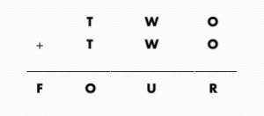



Crypt Arithmetic Puzzles
Constraints:
1. Variables: can take values from 0-9
2. No two variables should take same value
3. The values should be selected such a way that it should comply with arithmetic properties.

Slide 64
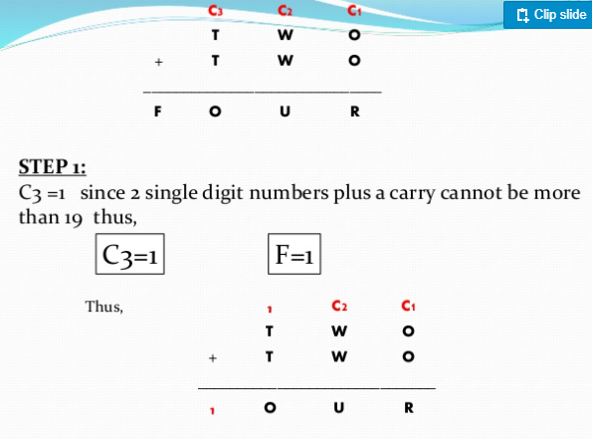

Slide 65
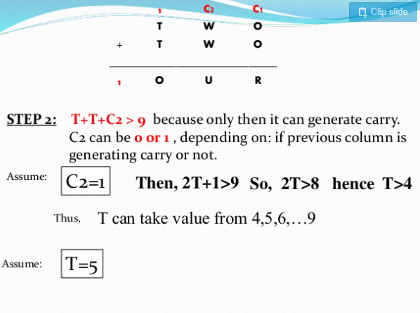

Slide 66
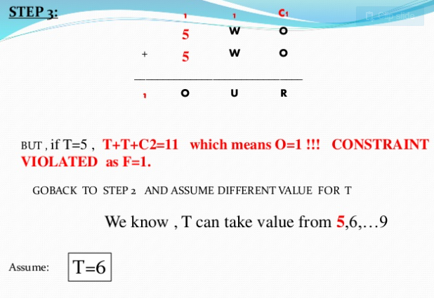

Slide 67
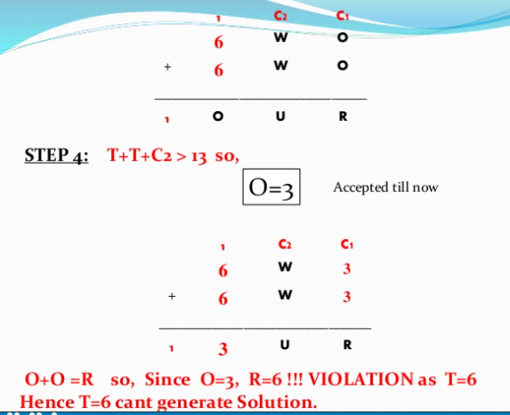

Slide 68
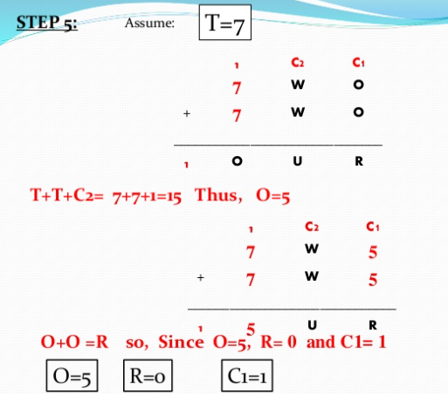

Slide 69
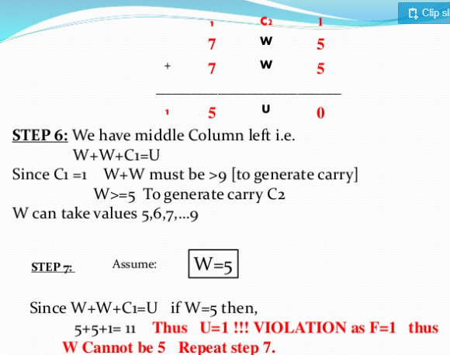

Slide 70
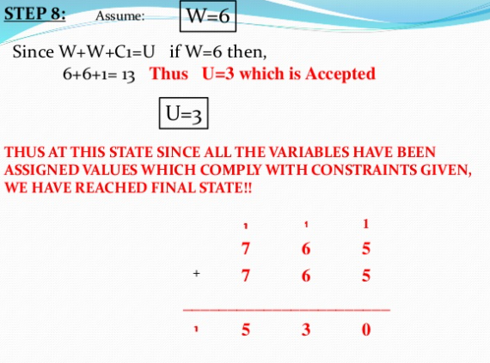













Slide 71




Constraint Domain
It describes different constrainers, operators, arguments, variables and their domains.
It consists of:
1. Legal set of operators
2. Set of variables
3. Set of all types of functions
4. Domain variables
5. Range of variables
constraint domain is five-tuple and represented as
D={var,f,O,dv,rg}

Slide 72
A constraint without conjuction is reffered as primitive constraint.
A conjuction of primitive constraints is called as non-primitive constraints or generic constraints.
The constraint problem can be visualisec as a constraint graph.
nodes represents the groups and the arcs define the constraint
One of the prime benefits is the easier representation of problem in the form of a standard pattern.

Slide 73
CSP as a Search Problem
Initial state:
{} – all variables are unassigned
Successor function:
a value is assigned to one of the unassigned variables with no conflict
Goal test:
a complete assignment
Path cost:
a constant cost for each step
Solution appears at depth n if there are n variables

Slide 74
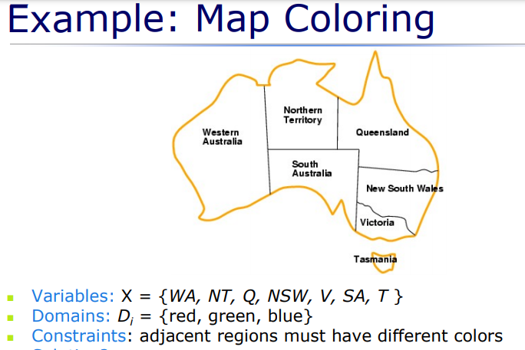

Slide 75
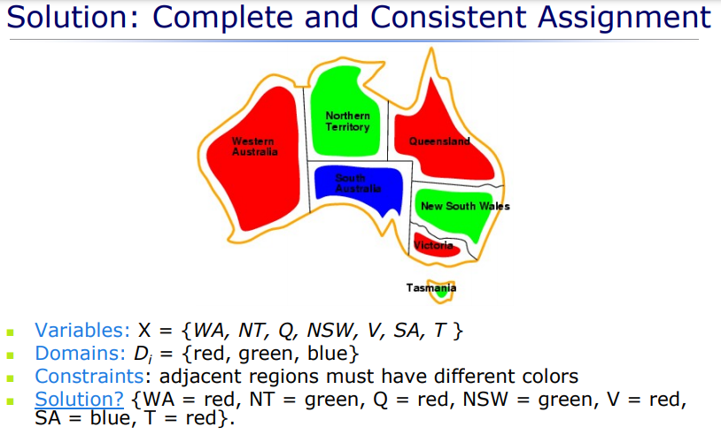

Slide 76

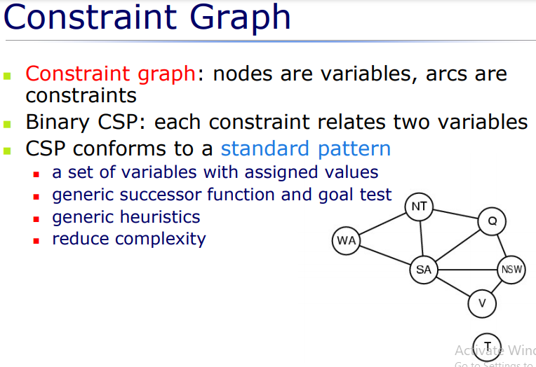



Slide 77
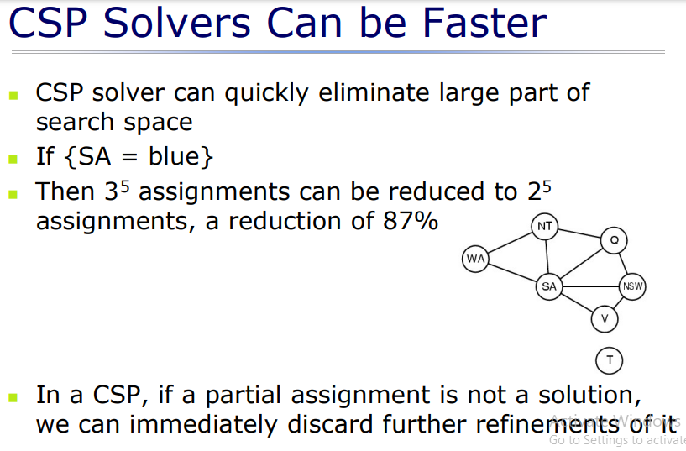

Slide 78
Backtracking Search for CSP
Assignment of value to any additional variable within constraint can generate a legal state (Leads to successor state in search tree).
Nodes in a branch backtracks when there is no options are available.
Backtracking allows to go to the previous decision-making node to eliminate the invalid search space with respect to constraints.
Heuristics plays a very important role here.
If we are in position to determine which variables should be assigned next, then backtracking can be improved.

Slide 79
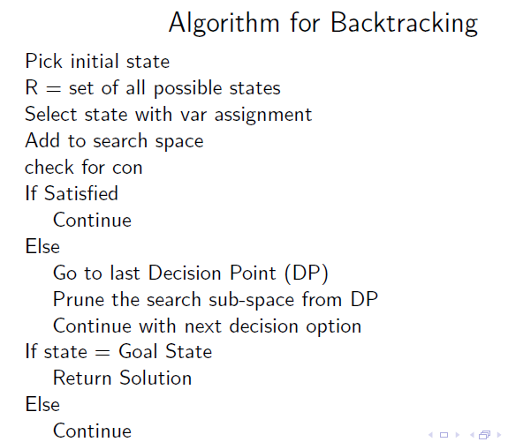

Slide 80
Role of Heuristic
Heuristics help in deciding the initial state as well as subsequent selected states.
Selection of a variable with minimum number of possible values can help in simplifying the search.
This is called as Minimum Remaining Values Heuristic (MRV) or Most Constraint Variable Heuristic.
The notion of selection is to detect a failure at an early stage.
It restricts the most search which ends up in same variable (which would make the backtracking ineffecctive).

Slide 81
MRV cannot have hold on initial selection process.
Node with maximum constraint is selected over other unassigned variables - Degree Heuristics.
By degree heuristics, branching factor cannot be reduced.
Selection of variables are considered not the values for it.
So, the order in which the values of particular variable can be arranged is tackled by least constraining value heuristic.

Slide 82
ForwardChecking
To understand the forward checking, we shall see 4 Queens problem.
If an arrangement on the board of a queen x, hampers the position of queens x+1, then this forward check ensures that the queen x should not be placed at the selected position and a new position is to be looked upon.

Slide 83
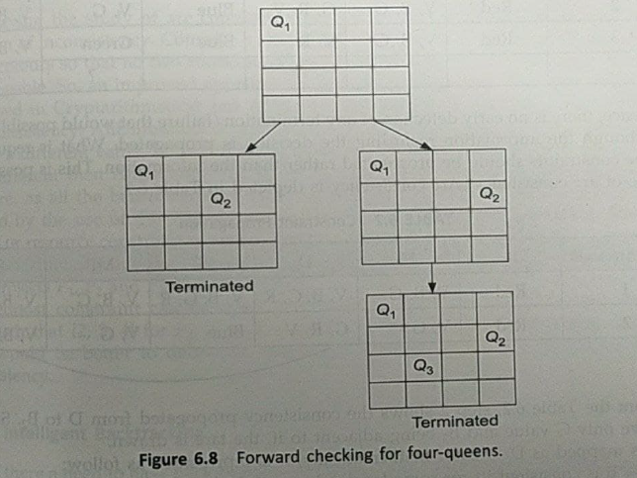

Slide 84
Q1 and Q2 are placed in row1 and 2 in the left sub-tree, so, search is halted, since No positions are left for Q3 and Q4.
Forward Checking keeps track of the next moves that are available for the unassigned variables.
The search will be terminated when there is no legal move available for the unassigned variables.

Slide 85
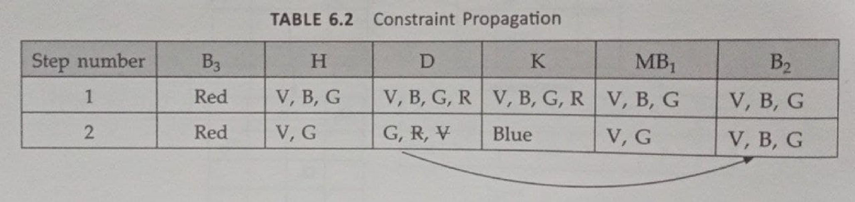
Constraint Propagation
There is no early detection of any termination/failure that would possible occur even though the information regarding the decision is propagated.
Constraint should be propagated rather than the information.

Slide 86
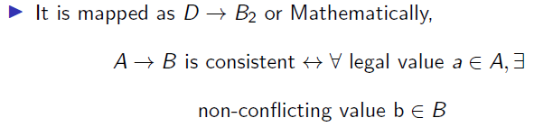
Step 2 shows the consistency propagated from Dto B2
Since D is can have only G value and B2 being adjacent to it, the arc is drawn.
Failure detection can take place at early stage

Slide 87
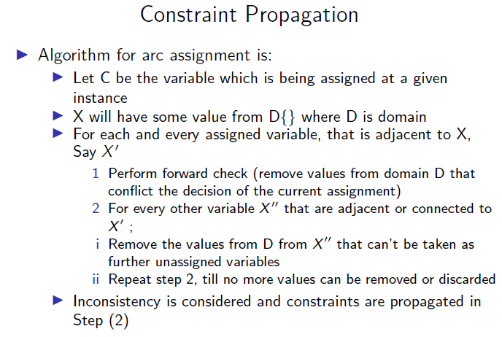

Slide 88
Intelligent Backtracking
Conflict set is maintained using forward checking and maintained.
Considering the 4 Queens problem,Conict needs to be detected by the user of conflict set so that a backtrack can occur
Backtracking with respect to the conflict set is called as conflict-directed backjumping
Backjumping approach can't actually restrict the earlier committed mistakes in some other branches

Slide 89
THANK YOU....

